Slide 1
IS204
System Analysis and Design
System Development
Methodologies, Models, Tools, and Techniques
COMPUTER INFORMATION SYSTEM DEPARTMENT ASS.LEC. ZAINAB H. ALFAYEZ

Slide 2
System Development Aids
Aside from an SDLC, systems developers have a variety of aids at their disposal to help them complete activities and tasks. Among them are methodologies, models, tools, and techniques. The following sections discuss each of these aids.
COMPUTER INFORMATION SYSTEM DEPARTMENT ASS.LEC. ZAINAB H. ALFAYEZ

Slide 3
System Development Methodology
A set of comprehensive guidelines for the SDLC that includes specific models, tools, and techniques.
Within a Methodology, certain:
Models, such as diagrams, are used to describe and specify the requirements.
Techniques for how the project team will do its work.
An example of a technique is the guidelines for conducting a user interview.
Tools usually computer-based tools to build models, record information, and write the code.
COMPUTER INFORMATION SYSTEM DEPARTMENT ASS.LEC. ZAINAB H. ALFAYEZ

Slide 4
Models
Model: is a representation of an important aspect of the real world.
For example, an airplane model.
Some models are physically similar to the real product. Some are graphical representations of important details. And some are abstract mathematical notations.
The models used in system development include representations of inputs, outputs, processes, data, objects, object interactions, locations, networks, and devices, among other things.
Most of the models are graphical models, are often called diagrams and charts, and the UML diagrams are examples.
COMPUTER INFORMATION SYSTEM DEPARTMENT ASS.LEC. ZAINAB H. ALFAYEZ

Slide 5
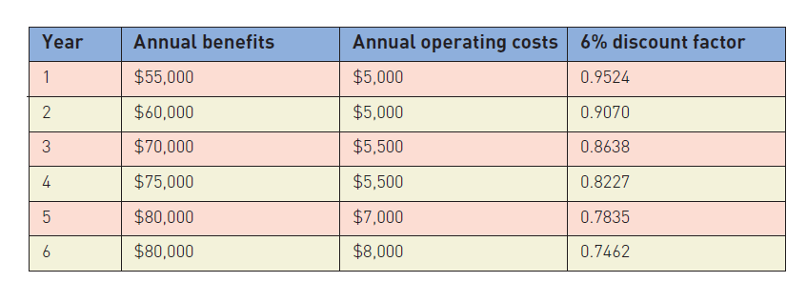
Project Planning Models
Another important kind of model.
Gantt chart or net present value (NPV).
COMPUTER INFORMATION SYSTEM DEPARTMENT ASS.LEC. ZAINAB H. ALFAYEZ

